Slide 1

PGB Session
4 December 2025
(Readahead)
Mr. Paul Wormeli
NIEMOpen Project Governing Board Chair

Slide 2
Need secretary/notetaker
7 PGB Members
Cabral Expert Voting Member replacing Renner
Need Cathie Mayo financials
Need 8 Oct and 13 Nov Reveal summary slides
NBAC & NTAC slides

Slide 3
CALL TO ORDER
Called to order the regular virtual meeting of the NIEMOpen Project Governing Board at 2 PM, 4 December 2025.
2

Slide 4
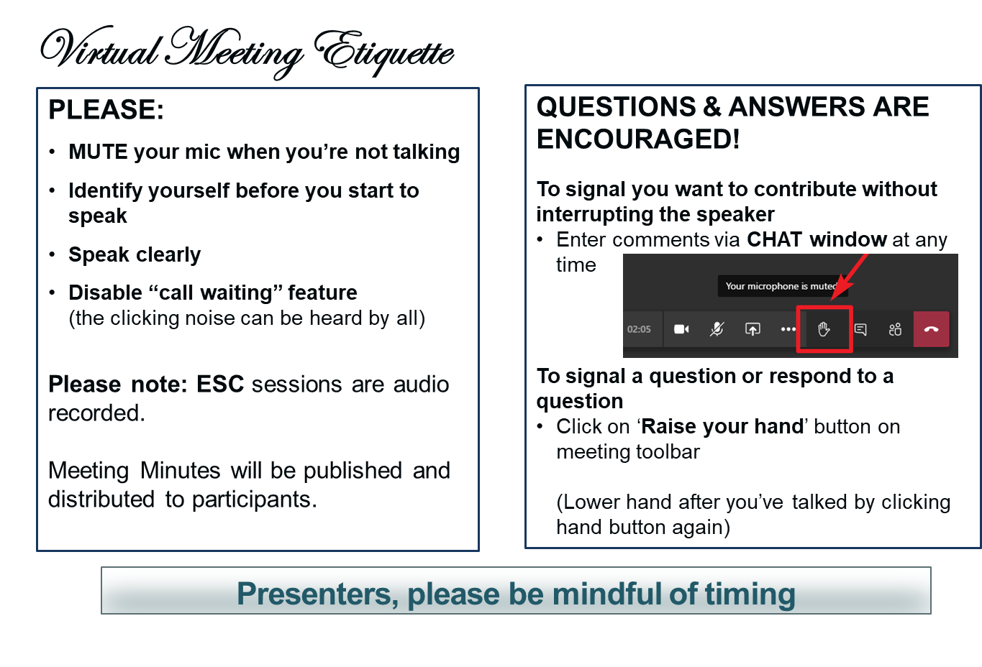
MAKING THE MOST OF OUR SESSION

Slide 5
VENUE
PGB Meeting
4 December 2025
Virtual Meeting 2-4 PM EST
– Virtual: ZOOM
4 December 2025
PGB Zoom Meeting
Join Zoom Meeting
https://us06web.zoom.us/j/8016452879?pwd=a3hNN0dieVJPR1pZY2QwbHVXbFJTUT09&omn=85908180890
Meeting ID: 801 645 2879
Passcode: 676136
One tap mobile
+13052241968,,8016452879#,,,,*676136# US
+13092053325,,8016452879#,,,,*676136# US
Join instructions
https://us06web.zoom.us/meetings/85908180890/invitations?signature=v7ueE3VX0wciFxK86TDOvU4-uHxhSlMjSZeynaKxCXo
PGB Minutes & documents: https://github.com/niemopen/oasis-open- project/tree/main/pgb-meeting-minutes

Slide 6

NOTE TAKER
Meeting support, note takers:
Secretary’s Name
Secretary’s Email

Slide 7
ROLL CALL
PGB Sponsor Voting Members (7):
  All Purpose Networks (APN)
  Commonwealth of Virginia, Office of Data Governance and Analytics (ODGA)
  Criminal justice Information Systems Division (CJISD), Federal Bureau of Investigation
  Department of Homeland Security Science & Technology (DHS S&T)
  Georgia Tech Research Institute (GTRI)
  Integrated Justice Information Systems Institute (IJIS)
  National Association for Justice Information Systems (NAJIS)
  Senzing, Inc.
PGB Expert Voting Members (3)
  NBAC TSC
  NTAC TSC
PGB Expert NON-Voting Members (3)
Quorum: 5
Notes:
Voting Members
Mr. Jim Herbert - All Purpose Networks (APN)
Ms. Christina Bapst-Stump - Department of Homeland Security Science & Technology (DHS S&T)
Mr. John Wandelt - Georgia Tech Research Institute (GTRI)
Mr. Paul Wormeli - Integrated Justice Information Systems Institute (IJIS)
Mr. Payton Lamb - Commonwealth of Virginia, Office of Data Governance and Analytics (ODGA)
Ms. April Michell - Criminal justice Information Systems Division (CJISD), Federal Bureau of Investigation
Mr. Tom Welch - National Association for Justice Information Systems (NAJIS)
Expert Voting Members
NBAC TSC - Mr. Thomas Krul (National Defence Canada)
NTAC TSC – Mr. Jim Cabral
PGB Expert Non-Voting Members(4)
NBAC TSC – Mr. Kamran Atri (A4Safe),
NTAC TSC – Mr. Brad Bolliger (EY)
Dr. Scott Renner (MITRE)

Slide 8

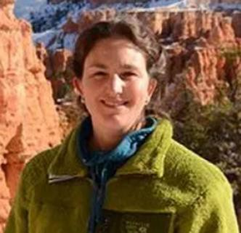
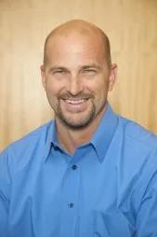
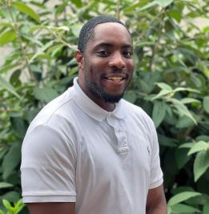
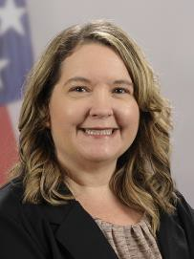
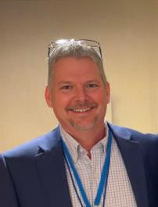
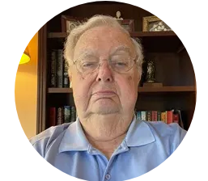
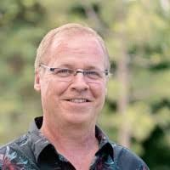
SPONSOR APPOINTED PGB VOTING MEMBERS
Mr. Payton Lamb Data Engineer Commonwealth of Virginia Office of the secretary of Administration
Office of Data Governance and Analytics
Mr. Paul Wormeli Co-Chair, NIEM Business Architecture Committee TSC
Ms. Christina Bapst-Stump
Science and Technology Directorate,
US Department of Homeland Security
Mr. John Wandelt Principal Research Scientist, Georgia Tech Research Institute
Ms. April Mitchell FBI It Specialist and Technical Lead of Data Standards in the Criminal Justice Information Services (CJIS) Division
Mr. Tom Welch Director of Information Technology OHIO HIDTA –
Including Northern KY & Western PA
Mr. James T. Herbert
VP, CMO
APN Software
Mr. Jeff Butcher
Chief Software Architect,
Senzing, Inc.

Slide 9
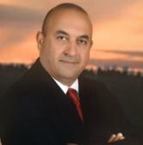
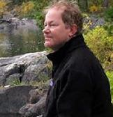
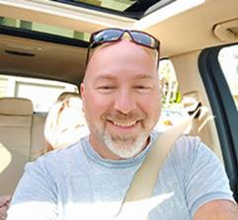
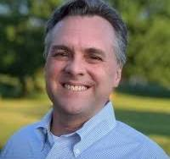
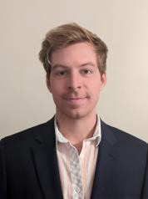
PGB EXPERT VOTING MEMBERS & NON-VOTING MEMBERS
PGB EXPERT VOTING MEMBERS
Technical Steering Committees
PGB EXPERT NON-VOTING MEMBERS
Technical Steering Committees
Mr. Brad Bolliger Co-Chair, NIEM Technical Architecture Committee TSC
Mr. Kamran Atri Co-Chair, NIEM Business Architecture Committee TSC
Dr. Scott Renner Co-Chair, NIEM Technical Architecture Committee TSC
Mr. Thomas Krul Co-Chair, NIEM Business Architecture Committee TSC
Mr. Jim Cabral - NTAC TSC

Slide 10
PROPOSED 4 DEC 2025 PGB AGENDA
Call to Order
Admin
  Call to Order
  ZOOM Link
  Note taker
  Roll Call & Introductions
    Sponsor Appointed PGB Voting Members (Sponsors)
    PGB Expert Voting Members (TSCs) & Non-Voting Members (TSC Co-Chairs)
Announcements
Approval of Meeting Agenda
Other Business
Around-the-Horn – PGB Voting Member Comments/Questions
2025 OASIS Staff / NIEMOpen Administrator
Q3 2025 Financial Snapshot – Cathie Mayo (OASIS)
Sponsor Update – Rita Petti/ Holly Peterson
CY 2025 Tasks
8 Oct NPC Meeting Update
13 Nov Reveal Summit Webinar Update
Co-Chair Discussion /Updates
NTAC Update –Jim Cabral & Dr. Scott Renner
NBAC Update – Thomas Krul
Next Meeting Schedule
Other Business/Discussion
Questions/Adjourn
Motions
Approval of 28 August PGB Minutes
Approval Chair Petty Cash Discretionary Fund
3. Approval for IJIS to take on functions formerly served by NMO
BREAK

Slide 11
APPROVAL OF AGENDA
Chair: A Draft Agenda for the NIEMOpen 4 December 2025 Project Governing Board (PGB) Meeting was provided to PGB Voting Members as a readahead.
Chair: Are there any recommended changes to the agenda as distributed?
Chair: If there are no (further) changes, the agenda stands approved as
(corrected).
?
Approve
Approve as Corrected

Slide 12
ANNOUNCEMENTS
Call for Consent
  NDR 6.0 and Model Version 6.0 approved by PGB as OASIS Candidate
  NDR 6.0 and Model Version 6.0 submitted for public review
Conducted 8 October NPC meeting
Forensics Townhall Postponed until 8 December 25 11 AM – 12 PM
Conducted 13 November Reveal Summit Webinar

Slide 13
Motions
PGB TOPICS FOR CONSIDERATION & VOTE
Approval of 28 August PGB Minutes
Approval of PGB Chair Petty Cash Fund
3. Explore Feasibility for IJIS to Service Functions Previously Supported by NMO

Slide 14
APPROVAL OF 28 August 2025 PGB MINUTES
Chair: A Draft of the NIEMOpen 28 August 2025 PGB meeting minutes was provided to the PGB Voting/Expert Voting Members as a readahead: Please let me know now if you found any errors: https://github.com/niemopen/oasis-open-project/blob/main/pgb-meeting-minutes/2025/4-dec-25/(DRAFT)%20NIEMOpen%20PGB%20Meeting%20Minutes%2028%20Aug%20%202025%20v1%208-20-25.docx
Chair: Are there any corrections to the minutes as distributed?
Chair: If there are no (further) corrections, the minutes stand approved as distributed (corrected).
?
Approve
Approve as Corrected

Slide 15
Motion to Establish a PGB Chair Petty Cash Fund
Chair: Approve a 5$K PGB Chair discretionary Petty Cash fund.
Maker: (Chair) I motion that the PGB approve an annual 5$K Petty Cash Fund available to the PGB Chair to purchase incidentals supporting the operations of NIEMOpen.
The Chair may expense incidental expenses at his discretion that support NIEMOpen operations.
Annual ceiling not to exceed $5K total.
Provides invoice/receipts to NIEMOpen for reimbursement.
Receipts required for any single expense greater than or equal to $500.00
SECOND?
Chair: Discussion
Chair: Are there nominations from the floor?
Chair: Records nominations.
Chair: Conducts a Full Majority Vote
Chair: Announces Vote
Resolution
?
Approve
Approve w/Comment
Table/Reject
Notes:
The Chair (Maker- Makers Name) makes a motion: I motion that …………………………………………………
2. Chair: “It is moved and seconded to adopt the motion.
3. Chair: Are there objections?
4. Chair: Those in favor of adopting the motion to approve say
‘Aye.’ [pause] Those opposed, say ‘No.’”
5. Chair: Announce the result
If no objections
6. Chair: Without objection, approved
7. Chair: Before we entertain nominations, I open the floor for discussion.
8. Chair: Are their nominations for a new Chair (s)? / nominations recorded.
9. Chair: Conduct the Vote
10. Chair: Those in favor of adopting the motion to approve say
‘Aye.’ [pause] Those opposed, say ‘No.’”
11. Chair: Announce the result.

Slide 16
Motion to Approve IJIS to Service Functions Previously Supported by NMO
Chair: Explore and test feasibility of IJIS serving in the role of the former NMO
Maker: (Chair) I motion that the PGB Chair enter discussions with IJIS to assess the feasibility of IJIS servicing functions formerly supported by the NMO.
The PGB Chair and IJIS shall:
Discuss scope of delegated functions/ activities
Propose a trial timeline
Discuss potential reimbursement by NIEMOpen as feasible to offset labor
Make recommendations for approval by PGB
SECOND?
Chair: Discussion
Chair: Are there nominations from the floor?
Chair: Records nominations.
Chair: Conducts a Full Majority Vote
Chair: Announces Vote
Resolution
?
Approve
Approve w/Comment
Table/Reject
Notes:
The Chair (Maker- Makers Name) makes a motion: I motion that …………………………………………………
2. Chair: “It is moved and seconded to adopt the motion.
3. Chair: Are there objections?
4. Chair: Those in favor of adopting the motion to approve say
‘Aye.’ [pause] Those opposed, say ‘No.’”
5. Chair: Announce the result
If no objections
6. Chair: Without objection, approved
7. Chair: Before we entertain nominations, I open the floor for discussion.
8. Chair: Are their nominations for a new Chair (s)? / nominations recorded.
9. Chair: Conduct the Vote
10. Chair: Those in favor of adopting the motion to approve say
‘Aye.’ [pause] Those opposed, say ‘No.’”
11. Chair: Announce the result.

Slide 17

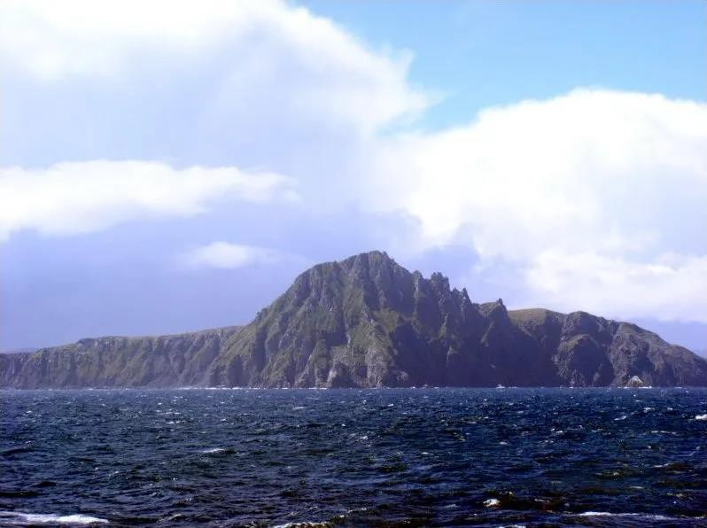
PGB MEMBERS: AROUND-THE-HORN

Slide 18

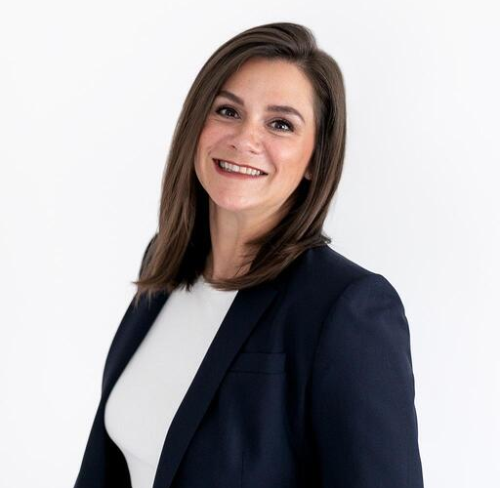
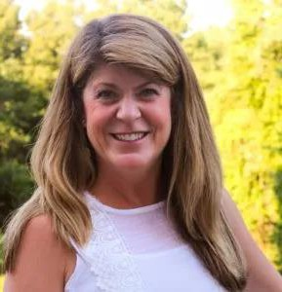
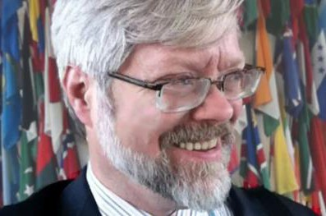
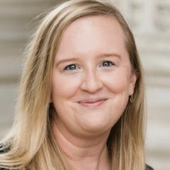
OASIS STAFF
Ms. Holly Peterson – OASIS Business Development Manager
Ms. Rita Petti – OASIS Director
of Business Development and
Partnerships.
Mr. James Bryce Clark –
OASIS General Counsel
Ms. Cathie Mayo – OASIS Chief Financial Officer
Ms. Kelly Cullinane – OASIS Senior Director of Standards Development

Slide 19
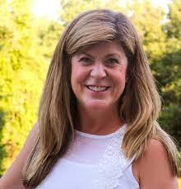
CY 2025 Q3 FINANCIALS
Ms. Cathie Mayo – OASIS Chief Financial Officer

Slide 20
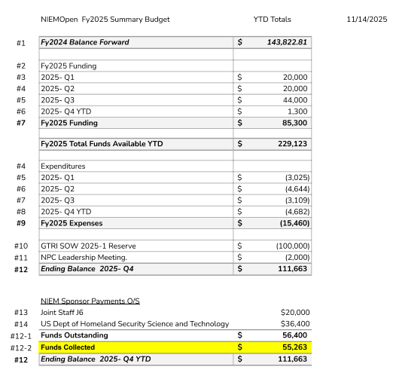

Slide 21
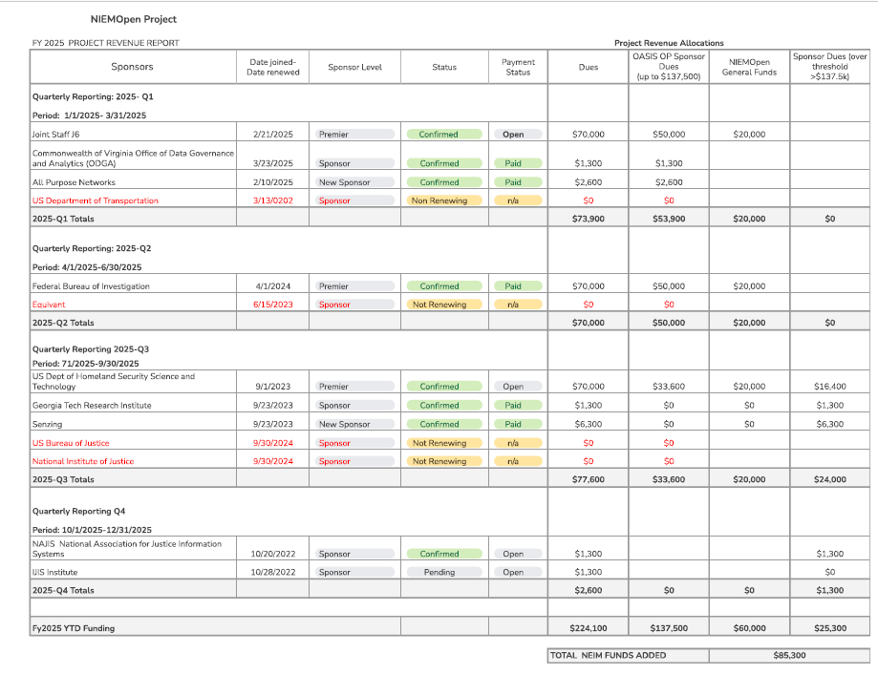

Slide 22
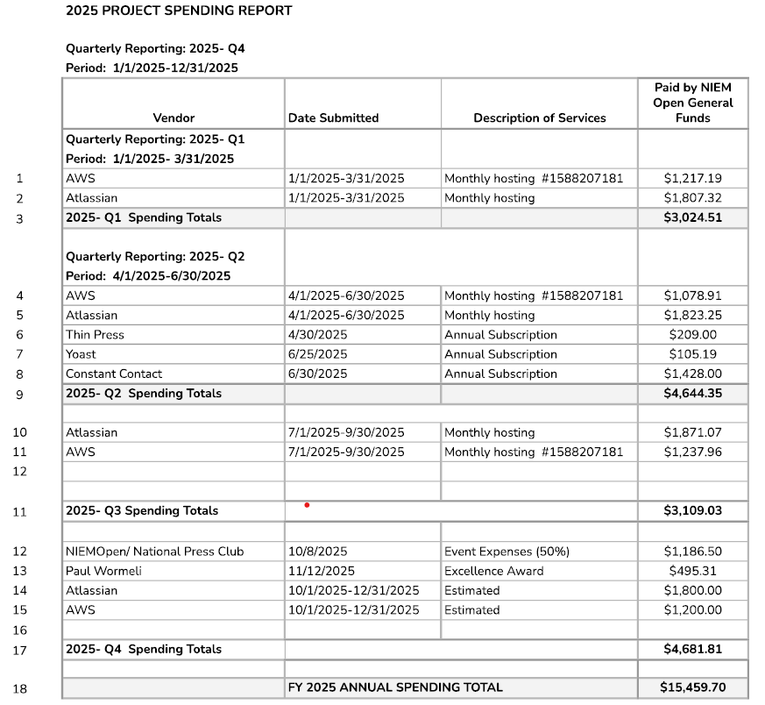

Slide 23
























NIEMOpen Current Sponsors
10 Sponsors, 3 Premier
Sponsors
DHS S&T
CJIS (FBI)
GTRI
NAJIS
IJIS
APN
ODGA (Virginia)
Premier
Premier
All Purpose Networks, Inc.
Sponsors in the Offing
DHS
OBIM
Office of Standards
Department of National Defense

Slide 24

CY 2025 NIEMOPEN PLANNING
Complete
NIEMOpen NDR v6.0 Project Specification Draft (PSD01) Approved
NIEMOpen NDR v6.0 PSD01 Approved
Update Training Materials reflecting Model v6.0 PS and NDR v6.0 PSD01
Incorporate training updates into LearnPress LMS & test
IOC API 2.0 User tools
Conduct 22 May Webinar
Onboard Forensics Domain/ Sub-Committee
Onboard Analytical Laboratories Domain
Conduct NBAC, NTAC & NMO Workgroup offsite (16-17 April 2025)
Stand-up NBAC. NTAC, NMO Workgroup
Execute OASIS- GTRI $100K Task Order for Developer Support
Elected new PGB Chair
Transition NMO
Planned/ In Progress 2025
Complete API 2.0 model management tasks
Promote NDR 6.0 & Model 6.0 to OS
Transition .gov website to NIEMOpen.org
Onboard Identity Management Domain/ Sub-Committee
Call for Consent issued 12 Nov
Recurring & Future
Identify Potential Sponsors & conduct Outreach
Conduct Synch w/ OASIS Staff as needed
Complete transfer of github.io files to NIEMOpen
Start Model v6.1 (2026)
Achieve Model 6.0 as ISO Standard (2026)

Slide 25
8 October Leadership Meeting Recap
The NTAC and NBAC meetings focused on clarifying roles and responsibilities in the new management structure, particularly regarding model updates and harmonization processes.
Major Topics
Funding Strategy Review
Commercial and Sustainable Transition
Harmonization & Role Clarification
Expending Domain Stewardship Challenges
Domain Stewardship & Revenue Challenges
Enhancing NIEM for unstructured Data
Data Prosessing Intergration

Slide 26
Reval Summit
Hosted by the IJIS Institute, the NIEMOpen Project Governing Board revealed Version 6.0 of NIEMOpen, the open-source framework for building a consensus on data standards that facilitate information sharing across domains
Keynote Speakers Comments
Kshemendra Paul, the first Program Manager of NIEM in 2005, noted that “NIEMOpen is not your father’s NIEM” as all the changes lead to a more contemporary capability
Teri Takai, Chief Programs Officer at the Center for Digital Government, described our digital future - how NIEMOpen should evolve to serve multiple domains in the age of AI
Dr. Kristen Honey, Chief Data Officer at the Department of HHS, spoke about the HHS open data project plans and the necessity of open data standards.

Slide 27
Reval Summit: Awards
2025 NIEMOpen Award of Excellence – presented to Sonoma County, CA, for its innovative application of the NIEMOpen Application Programming Interface (API) in designing a data model in the form of an ontology for a knowledge graph, which powers the modernized integrated justice information system that Sonoma is developing.
The NIEMOpen Domain Service Award - recognize the two new domains:
  Defense Forensics and Biometrics Agency (DFBA) for the Forensics domain
  Data Standardization Subgroup of the Integrated Consortium of Laboratory Networks (ICLN), under the Office of Health Security in the U.S. Department of Homeland Security, for the Analytical Laboratories domain
Chairman’s award - presented to Dr. Scott Renner for his work in developing the common model format and the accompanying Naming and Design rules for Version 6.0 of NIEMOpen.

Slide 28
UPDATES
TSC Updates
  NTAC Update – Mr. Jim Cabral & Dr. Scott Renner
  NBAC Update – Mr. Thomas Krul & Mr. Kamran Atri

Slide 29
NTAC TSC UPDATE
NIEMOpen 6.0 model and NDR promoted to Candidate OASIS specification
Initial discussions of NIEM release schedule
IJIS survey in early 2026 of feature requests for future release
Virtual F2F

Slide 30
NBAC TSC UPDATE
2 New Domains: Forensics and Analytic Laboratories
Model Version 6.0 and NDR 6.0 Call for Consent issued 12 Nov - pathway to OASIS Standard
Next NBAC Meeting 29 Jan
New NBAC prospective Secretary Michael Simcock

Slide 31
PGB Meeting Schedule – Pending Approval
NEXT PGB Meeting
Thursday, 19 March 2026
Virtual Meeting 2 – 4 PM EST
  Virtual: ZOOM
CY 2026 Meeting Dates
Q1 | MAR 19 | 2 – 4 PM | EDT
Q2 | JUN 18 | 2 – 4 PM | EDT
Q3 | SEP 17 | 2 – 4 PM | EDT
Q4 | DEC 3 | 2 – 4 PM | EST

Slide 32

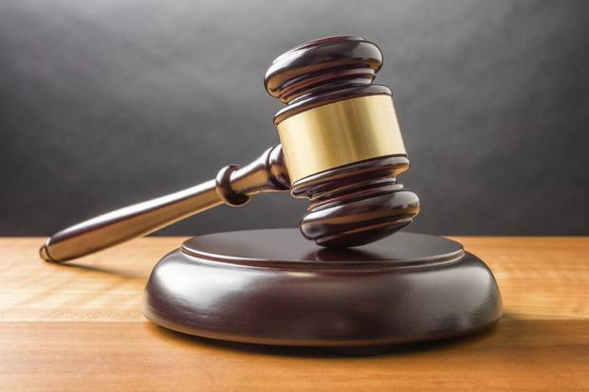
ADJOURN
Chair: Do any of the PGB members or our attending guests have any questions?
Chair: Meeting Adjourned

Slide 33

BREAK

